Slide 1
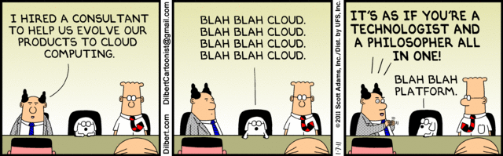
12 Factor Apps
Subhra Roy

Slide 2
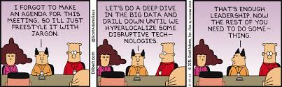
Agenda
Modern Day Software and Cloud
Software Erosion at Scale
The 12 Factors you need to consider
Summary
Questions

Slide 3
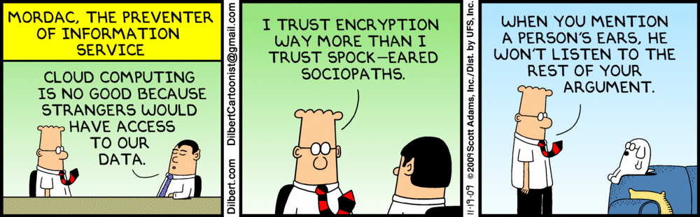
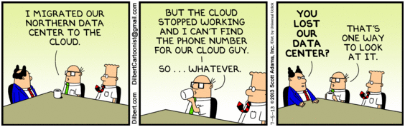
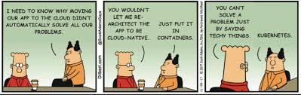
Modern Day Software and Cloud
Rise of Containers
IOT
Mobile Apps
On Demand
AWS
Virtualization
Use as a Service
No of Concurrent Users
Who maintains/Owns the Infra
Security
Fallacies of Distributed Software
Lot of Unknowns
Amount of Data
Micro Services
Complex Deployments
Failures at Scale

Slide 4
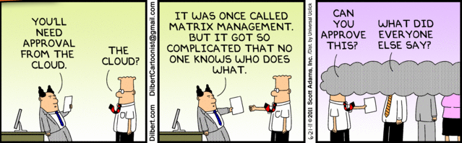
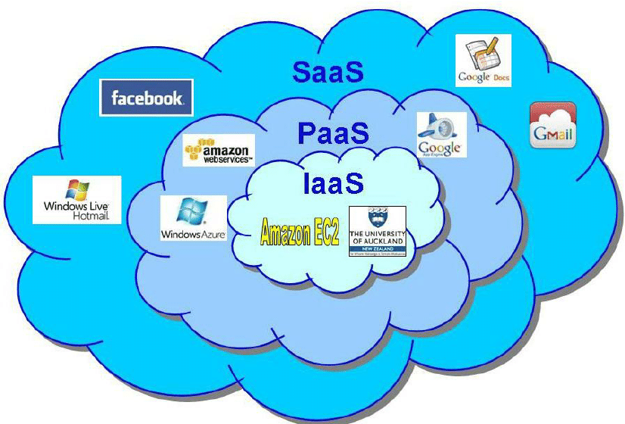
Cloud – The symbol of unknown
Used in architecture diagrams to show unknown or things we are not bothered with.
PHAAS
FAAS
HAAS

Slide 5
Software Erosion – Cause of P1 yesterday for SIM
Erosion Happens by the course of time.
Even when you did not make any changes to the software
Technology Changes, Related Software Changes, OS changes Hardware Changes
It is as inevitable as Time.
And that true for every server you have got
Yes all those additional ones with spring boot called Micro Services will get eroded too
And the extra servers means erosion X no of servers
And Cloud means you don’t know if they are eroding, cause you don’t know where you are deploying

Slide 6
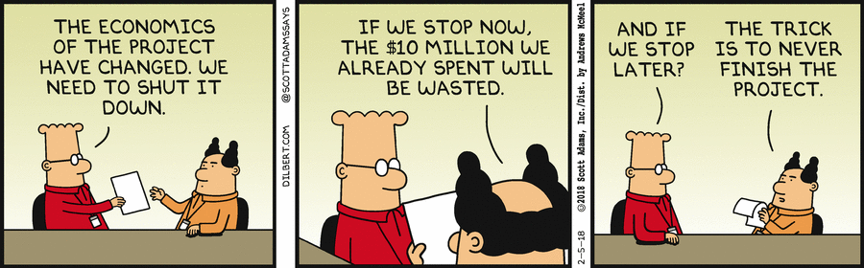
Software Erosion – Trick is to know when we need to change
And the Measures that can delay it

Slide 7
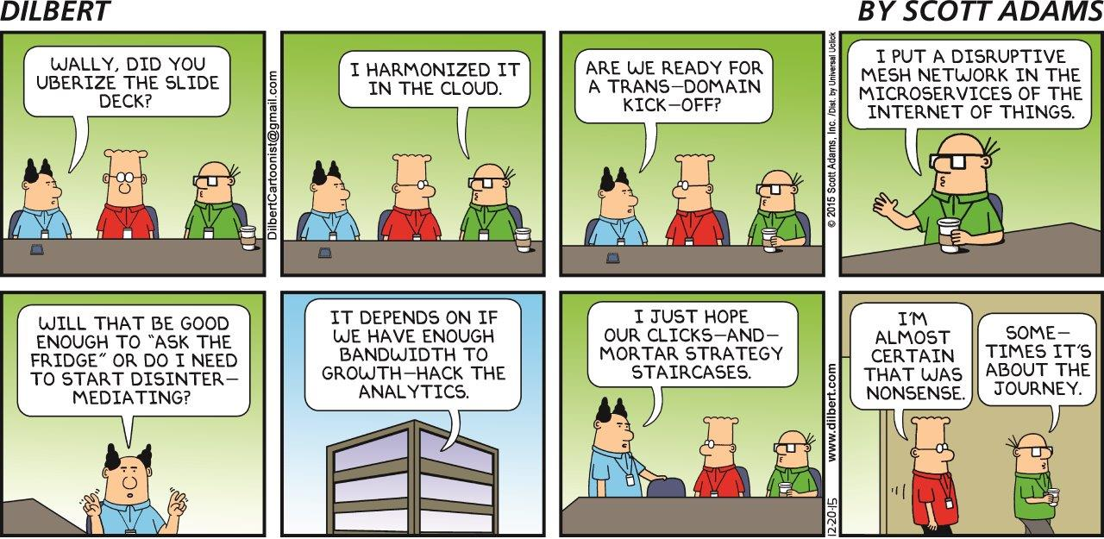
12 Factors – 12 rings to rule the Cloud

Slide 8
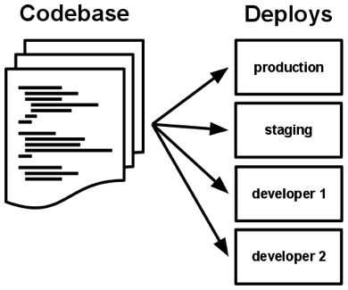
12 Factors – 12 rings to rule the Cloud
Code Base – 1 Codebase many Deploys
There is always a one-to-one correlation between the codebase and the app:
If there are multiple codebases, it’s not an app – it’s a distributed system. Each component in a distributed system is an app, and each can individually comply with twelve-factor.
Multiple apps sharing the same code is a violation of twelve-factor. The solution here is to factor shared code into libraries which can be included through the dependency manager.

Slide 9
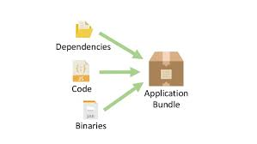
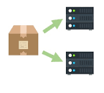
12 Factors – 12 rings to rule the Cloud
Dependencies – Explicitly declare dependencies
Never Expect something to be just there or pre-existing in the host
Declare what you depend on explicitly
Package it along with your bundle

Slide 10
12 Factors – 12 rings to rule the Cloud
Config - Store Config in Environment
An app’s config is everything that is likely to vary between deploys (staging, production, developer environments, etc)
Resource handles to the database, Memcached, and other backing services
Credentials to external services such as Amazon S3 or Twitter
Per-deploy values such as the canonical hostname for the deploy
NO config constants in Code, Yes Strictly NO and I mean it. Config changes per deployment (environment) Code does not.

Slide 11
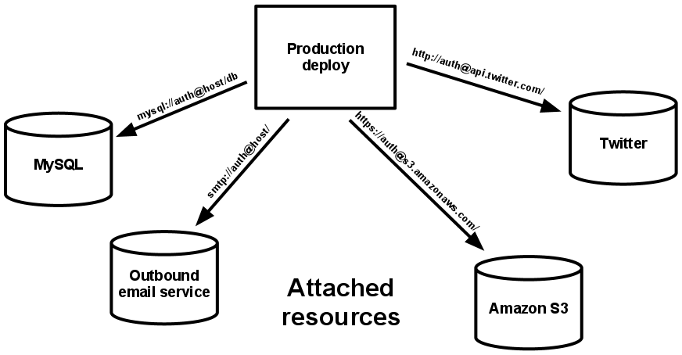
12 Factors – 12 rings to rule the Cloud
Backing Services - Treat as Attached Resources
A backing service is any service the app consumes over the network as part of its normal operation.
The code for a twelve-factor app makes no distinction between local and third party services.
Access via URI from Config

Slide 12
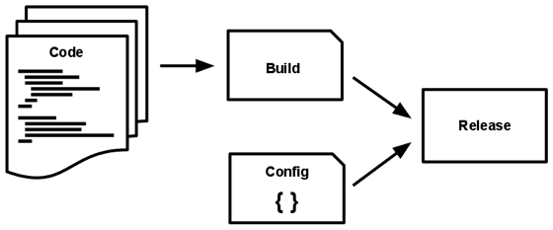
12 Factors – 12 rings to rule the Cloud
Build Release Run – Strictly separate these stages
A codebase is transformed into a (non-development) deploy through three stages:
The build stage is a transform which converts a code repo into an executable bundle known as a build.
The release stage takes the build produced by the build stage and combines it with the deploy’s current config. The resulting release contains both the build and the config and is ready for immediate execution.
The run stage (also known as “runtime”) runs the app in the execution environment, by launching some set of the app’s processes against a selected release.

Slide 13
12 Factors – 12 rings to rule the Cloud
Processes – Execute App as one or more stateless processes
The app is executed in the execution environment as one or more processes.
Twelve-factor processes are stateless and share-nothing.
Yes that means NO SESSION, no Static HashMaps, no embedded Solr nor EhCaches .
Any such thing has to be externalized to a Backing Service

Slide 14
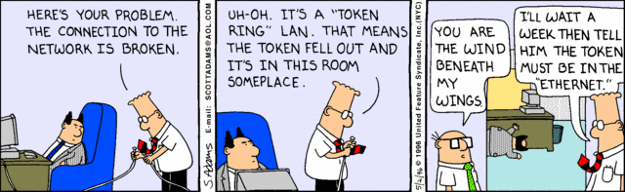
12 Factors – 12 rings to rule the Cloud
Port Binding – Export Services via Port Binding
The twelve-factor app is completely self-contained it does not depend on for example Web Server to route to the APP
This means one web server should have only one web-app bound to one port.
2nd Web app should be deployed separately in a separate process. Ideally on a different IP
This allows one service to be a backing resource for another service

Slide 15
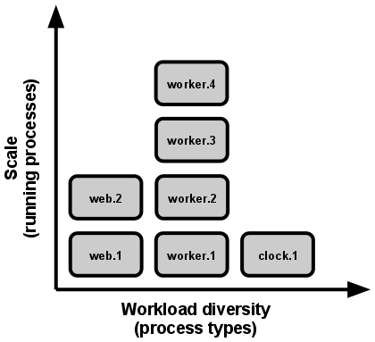
12 Factors – 12 rings to rule the Cloud
Concurrency – Scale out via Process Model.
In the twelve-factor app, processes are a first class citizen.
Be able to span multiple processes running on multiple physical machines.
It works only when they are stateless – SIM is not HA
Threads can scale only that much but it does not mean they should not be used.
Use different process types (web apps should not run schedulers).

Slide 16
12 Factors – 12 rings to rule the Cloud
Disposability – Fast Startup and Graceful Shutdowns
The twelve-factor app’s processes are disposable, meaning they can be started or stopped at a moment’s notice.
Processes should strive to minimize startup time.
Sim takes more than an hour to start
Processes should shut down gracefully allowing any current requests to finish, and then exiting.
Processes should also be robust against sudden death, in the case of a failure in the underlying hardware.

Slide 17
12 Factors – 12 rings to rule the Cloud
Dev/Prod Parity – Keep Dev, QA, Staging and Prod similar
The time gap: A developer may work on code that takes days, weeks, or even months to go into production.
The personnel gap: Developers write code, ops engineers deploy it.
The tools gap: Developers may be using a stack like Nginx, SQLite, and OS X, while the production deploy uses Apache, MySQL, and Linux.
The twelve-factor app is designed for continuous deployment by keeping the gap between development and production small.
Time Between Deploys should be Hours not weeks and never months.

Slide 18
12 Factors – 12 rings to rule the Cloud
Logs – Treat Logs as Event Streams
Logs provide visibility into the behavior of a running app and are normally written into a logfile.
Logs are the stream of aggregated, time-ordered events collected from the output streams of all running processes and backing services.
A twelve-factor app never concerns itself with routing or storage of its output stream. It should not attempt to write to or manage logfiles. Instead, each running process writes its event stream, unbuffered, to STDOUT.

Slide 19
12 Factors – 12 rings to rule the Cloud
Admin Processes – Run admin tasks as one-off processes
Running database migrations
Running a console (also known as a REPL shell) to run arbitrary code or inspect the app’s models against the live database. Most languages provide a REPL by running the interpreter without any arguments or in some cases have a separate command.
Running one-time scripts committed into the app’s repo
iSupplier Utilities – Could have qualified only if they followed all other 11 factors and the rule 3 – ONE TIME ONLY
Admin code must ship with application code to avoid synchronization issues.

Slide 20
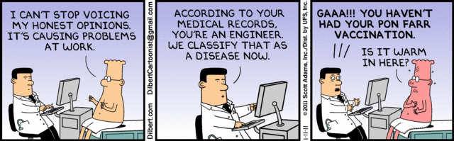
Surprise – 13th ring (Allows all other rings to work)
Health Check APIs – Who doesn’t care about his own health
Each APP should expose a standard url for checking the health of the app.
Each APP should check the health of the backing service before calling it
Fail gracefully or be resilient to health issues of backing services
Monitor own health and report correctly, accept request only if healthy

Slide 21
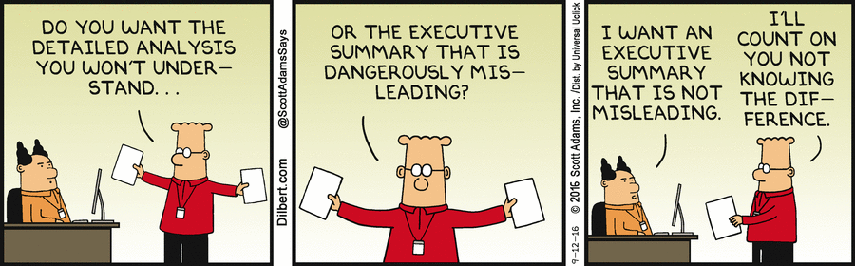
Summary

Slide 22
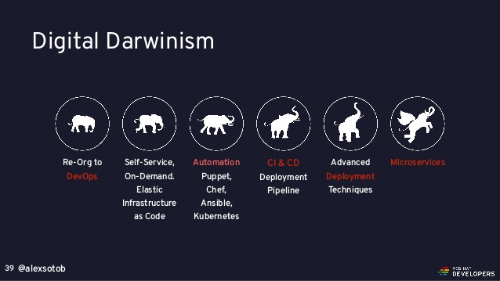
Stolen from REDHAT ☺

Slide 23
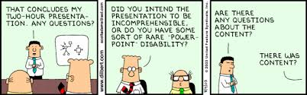
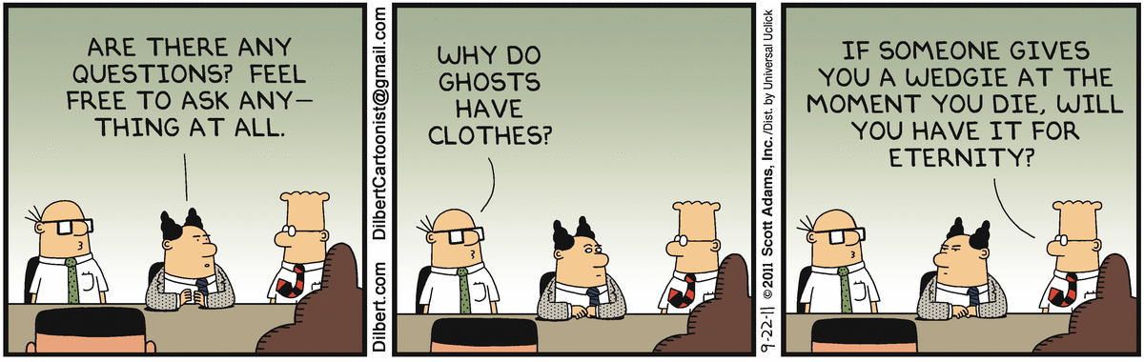
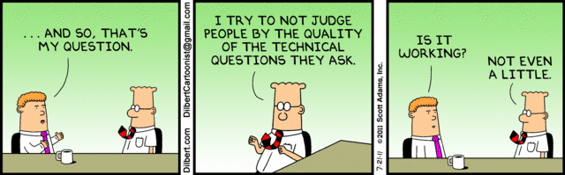
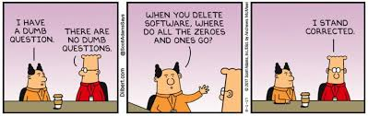
?

Slide 24
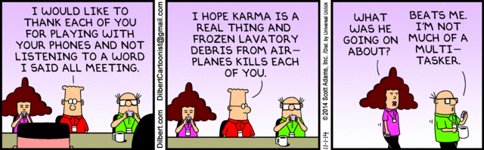
Thanks

